Slide 1
Automated Hyperspectral Imaging
Master’s Defense | Non-Thesis option Jorian Bruslind | Electrical Engineering

Slide 2
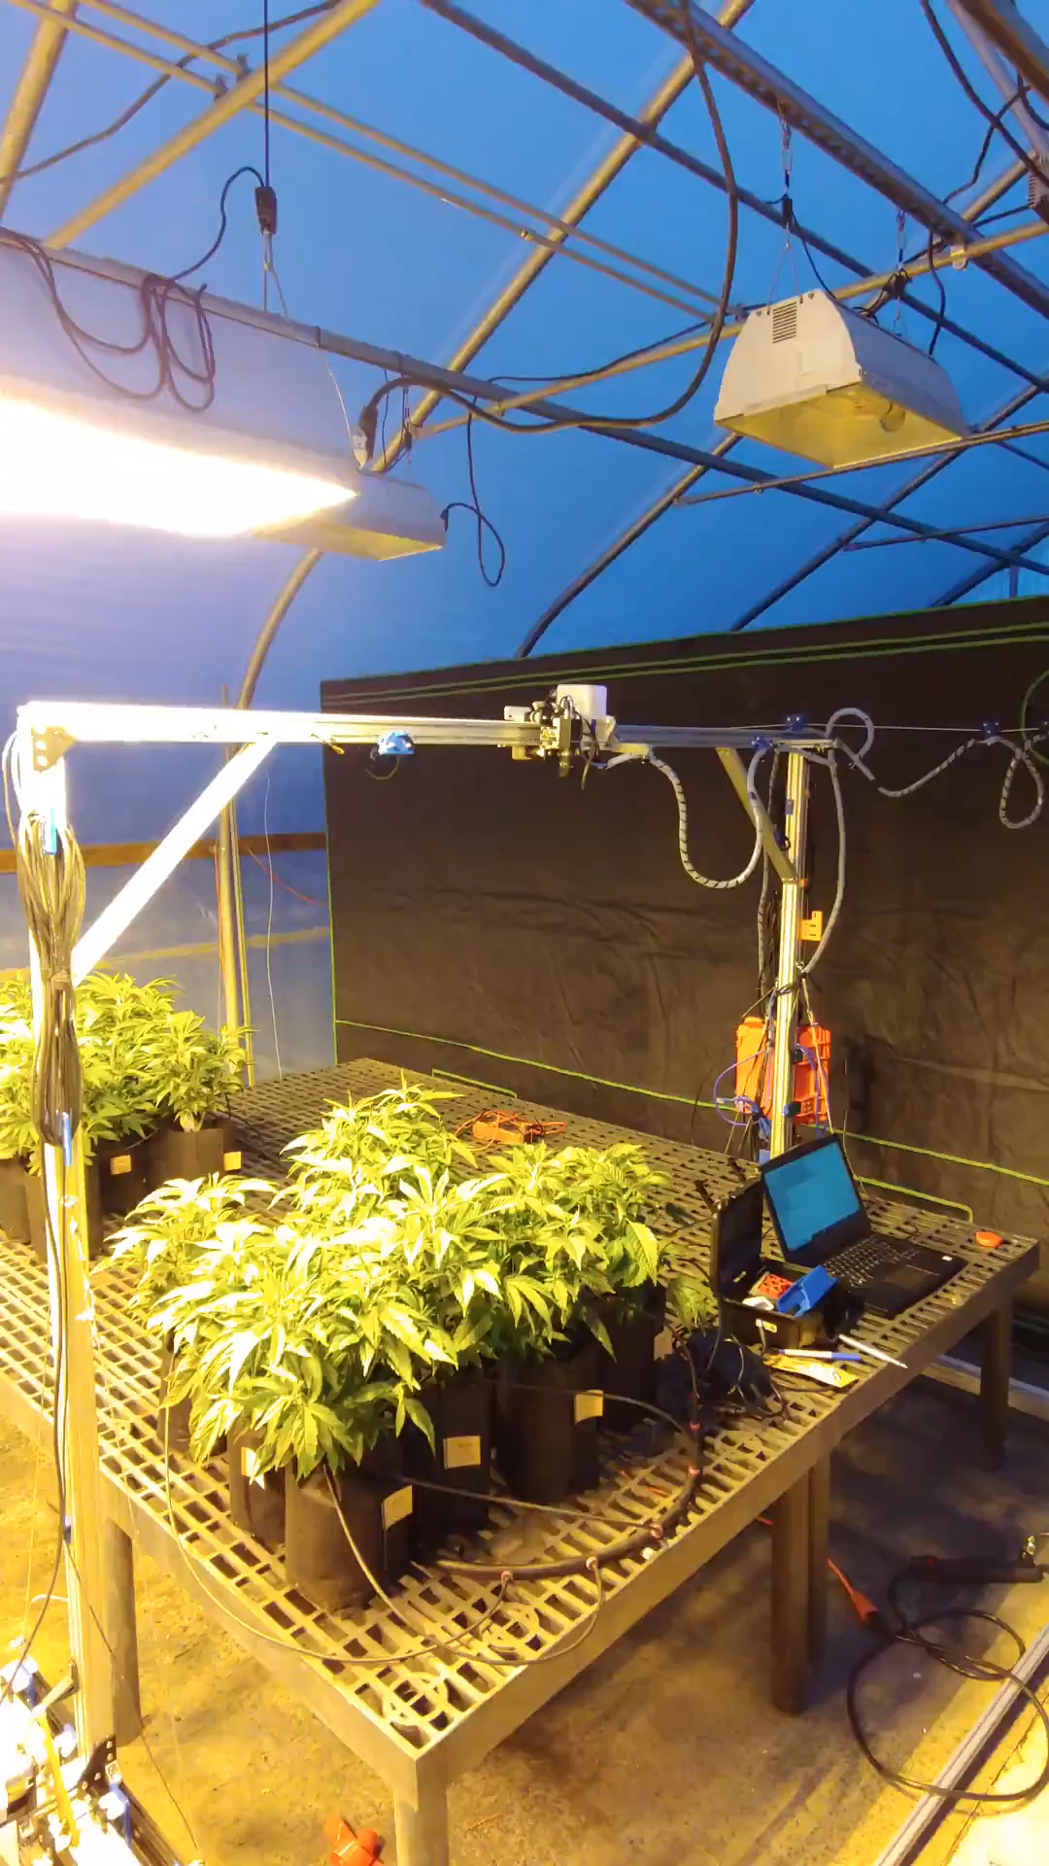
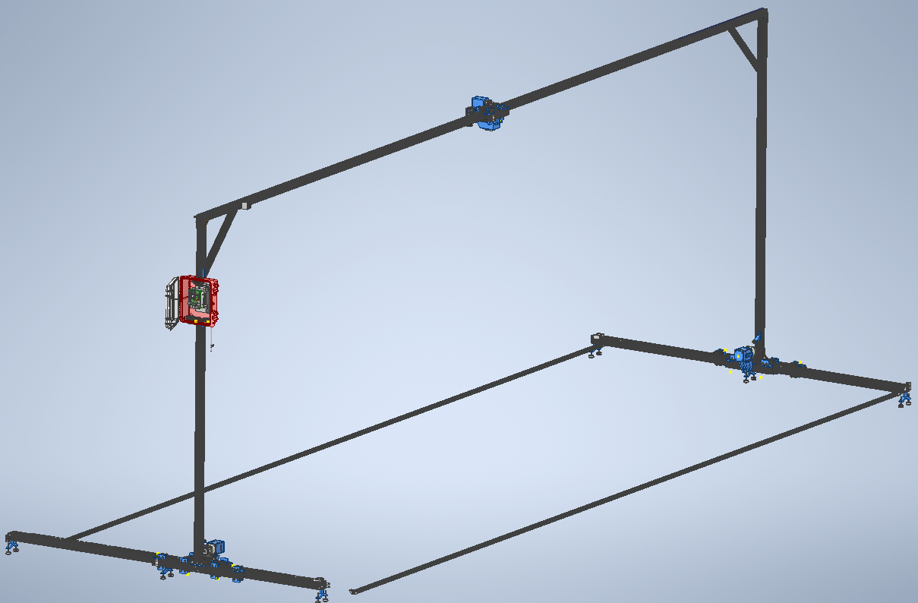
Project Preview
Notes:
NWREC – North Willamette Reach and Extension Center

Slide 3
Presentation Brief
Project Overview
Mechanical Design
Electrical Design
Software Design
Reflections and Lessons Learned

Slide 4

Project Overview

Slide 5
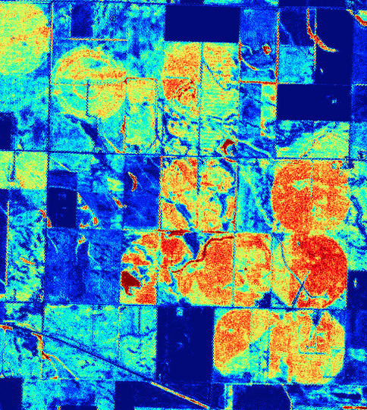
Background
Hyperspectral imaging is an important component of NDVI analysis
Imaging systems can be used on drones but can miss small details
Repeatability and time variation are critical
"Flickr." Flickr, 2 Mar. 2022, www.flickr.com/photos/mapbox/12322495485.
Notes:
What is HyperSpectral imaging and NVDI? Example uses include growth experiments, nutrient efficiency, etc
Repeatablity is import for time variation

Slide 6
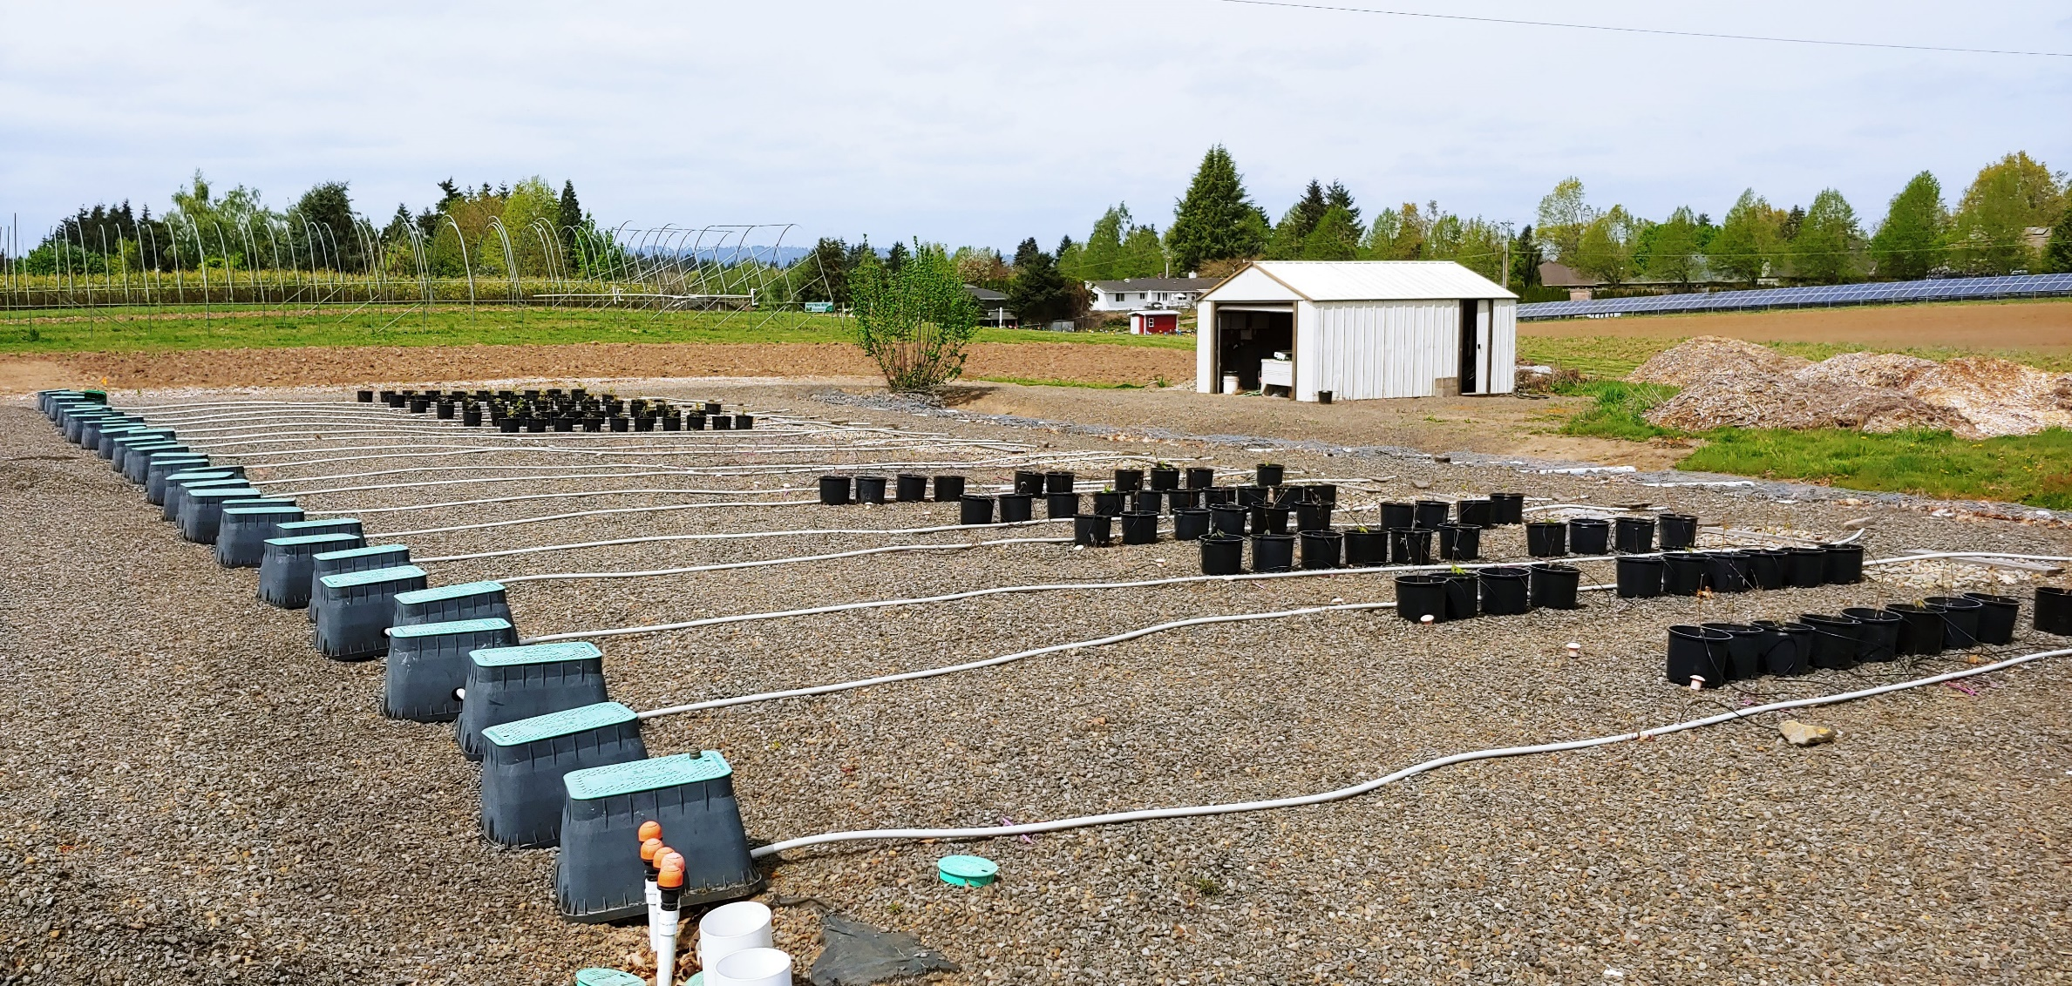
Planned Operation
Notes:
Let’s talk about the project itself,
Large area
Weatherproof (outdoor area)
Modular
Plug and play
User Interface

Slide 7
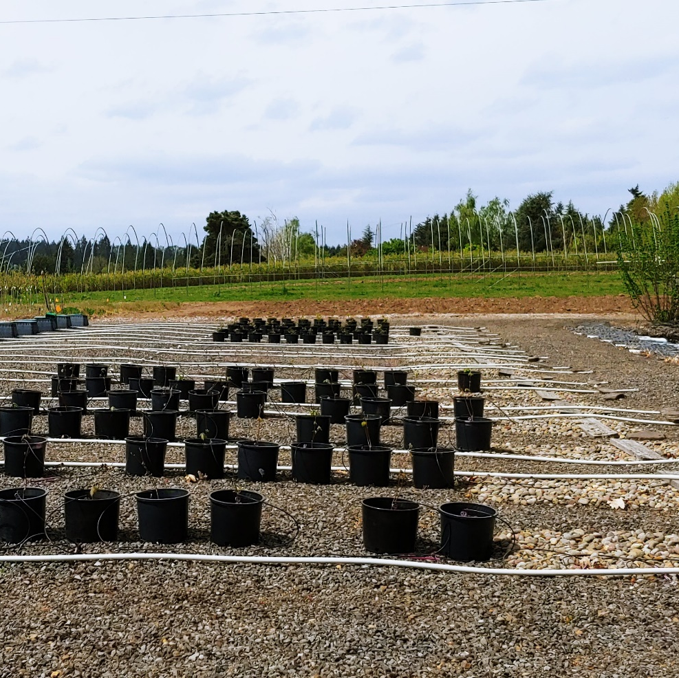
Project Requirements
1D / 2D mounted camera for automated crop imaging
20’ x 90’ possible area
Weatherproof
Modular design for size constraints
Plug and Play Electronics
Easy to use User-Interface and data management
Notes:
Let’s talk about the project itself,
Large area
Weatherproof (outdoor area)
Modular
Plug and play
User Interface

Slide 8
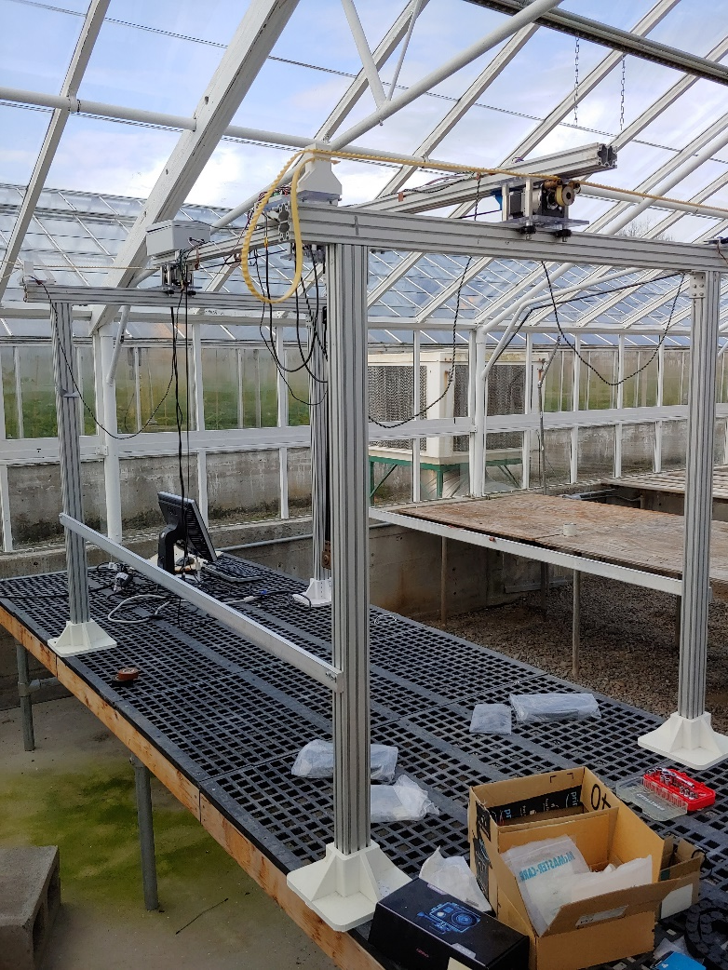
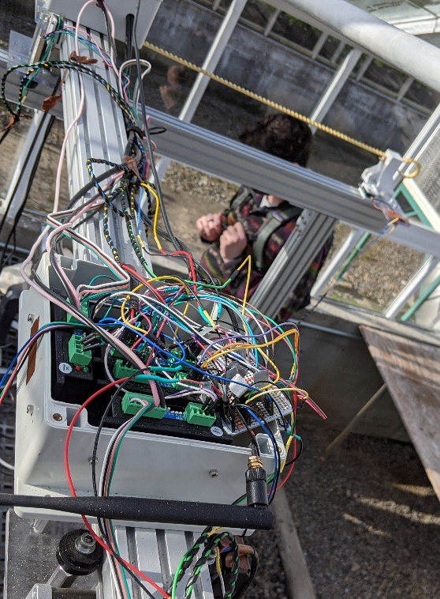
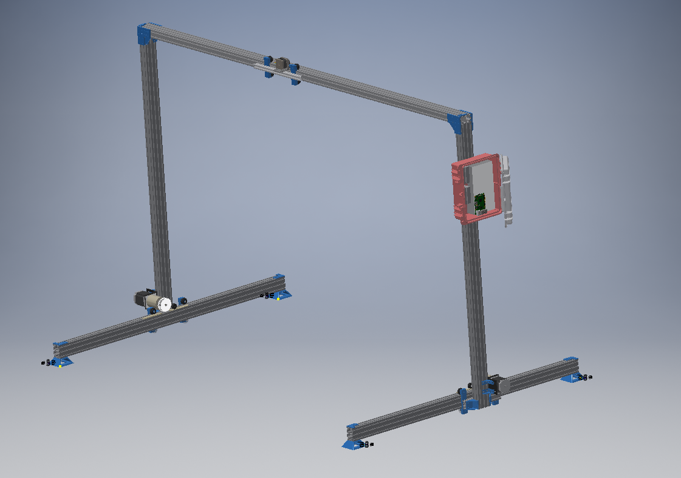
Project Timeline
Project Start
Winter 2021
High-level requirements
Rough Prototype in CAD
General feasibility assessment
Electrical Junior Design Teams
Notes:
I started working on the project Winter term of last year (2021)
Started by assessing the requirements for the system
Prototyped a rough model using CAD software (Inventor)
Assessed the feasibility using my experience along with research on other systems
Worked with Electrical capstones to operate the provided hardware as-is
Had to completely redesign and update the current materials for capstone use / testing

Slide 9
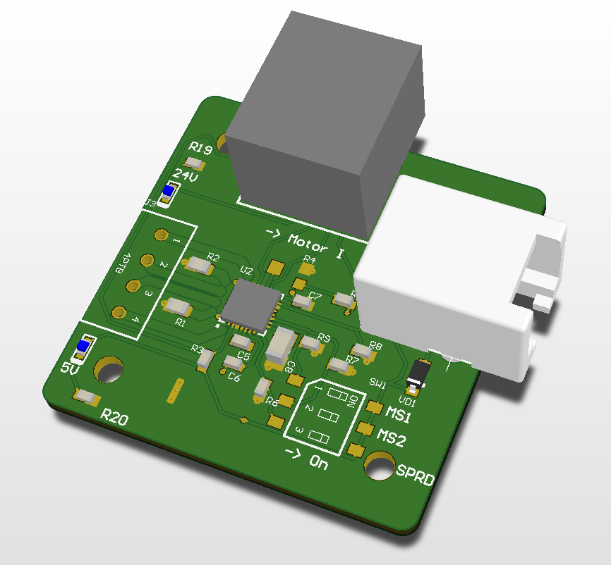
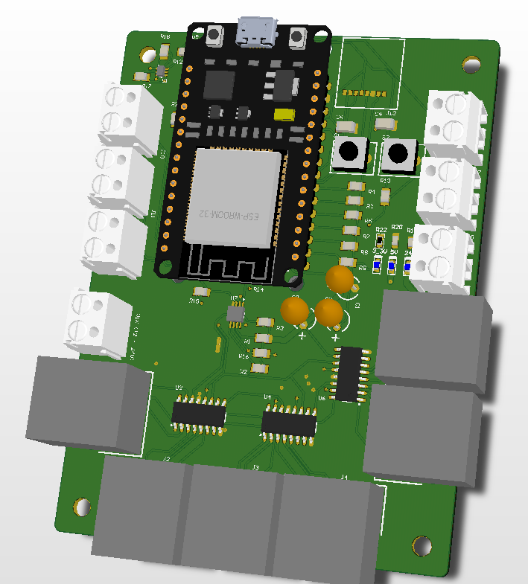
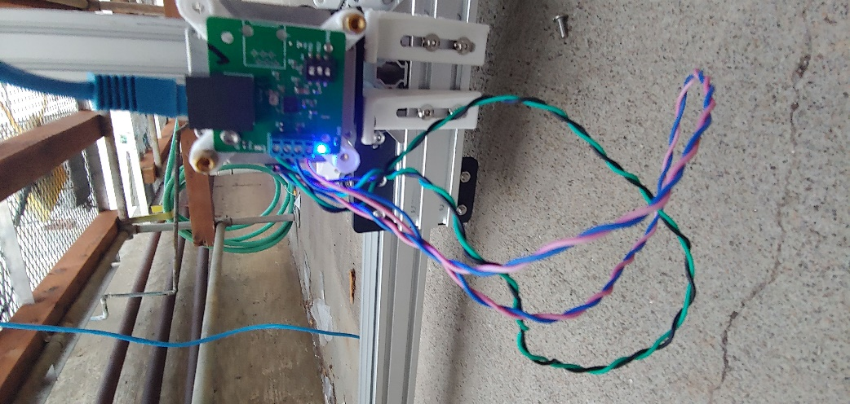
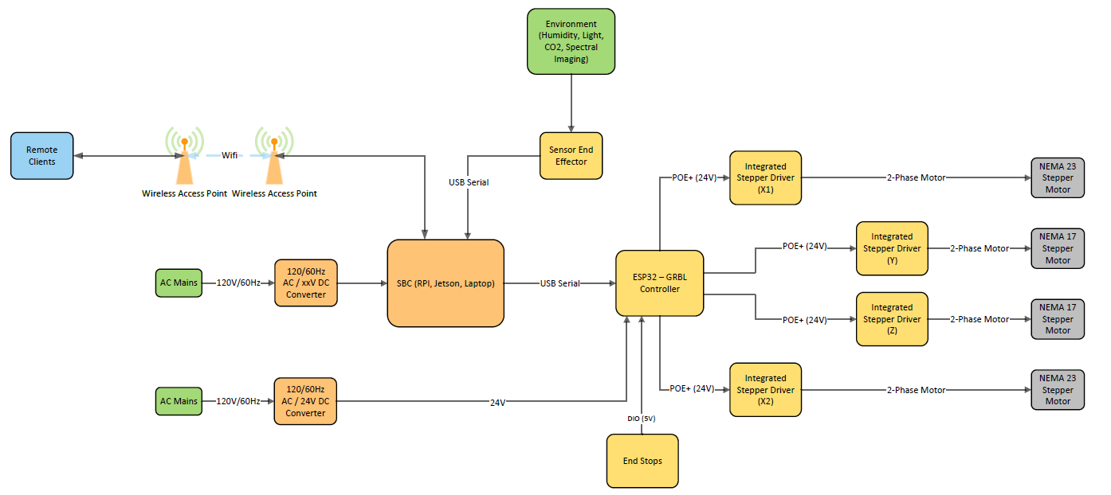
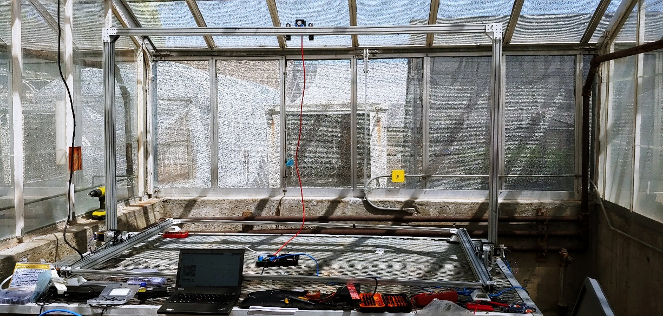
Project Timeline
Project Start
Winter 2021
First Revision
Sp/Su 2021
Detailed requirement list
System Block Diagram
Accurate CAD model (Rev 1.0)
PCB Design and Assembly
Notes:
The next spring and summer terms were devoted to refining the rev 1.0 prototype and developing the electronics sub-system
Finalized a requirements list along with specifications for each requirement
Created a System Block diagram for the electronics
Based on block diagram, developed PCBs and verified operation

Slide 10
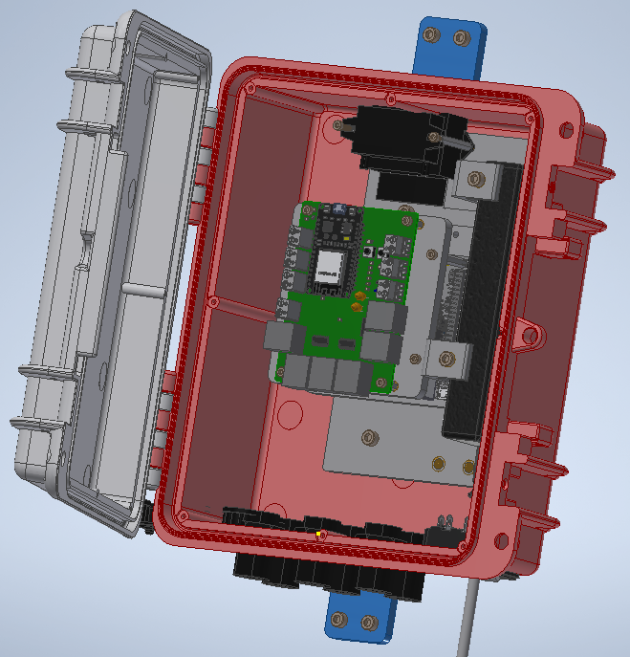
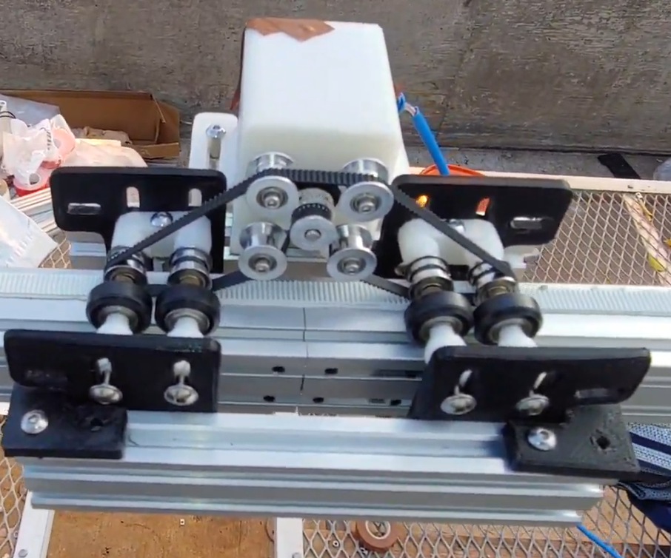
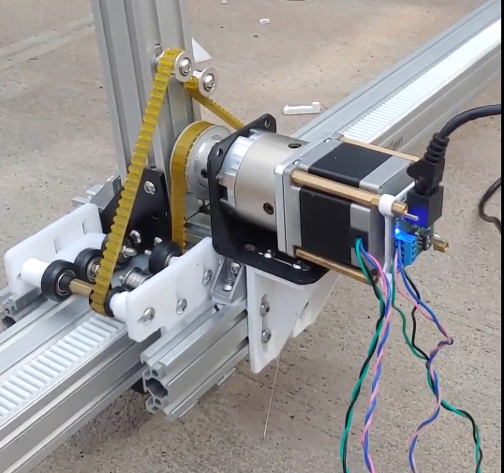
Project Timeline
Project Start
Winter 2021
First Revision
Sp/Su 2021
Second Revision
Fall 2021
Hardware Integration
Update CAD model (Rev 2.0)
Software Capstone Team
Rigorous verification

Slide 11
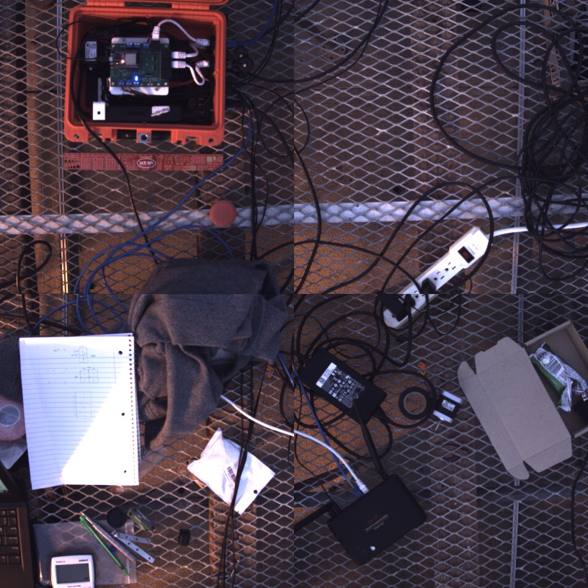
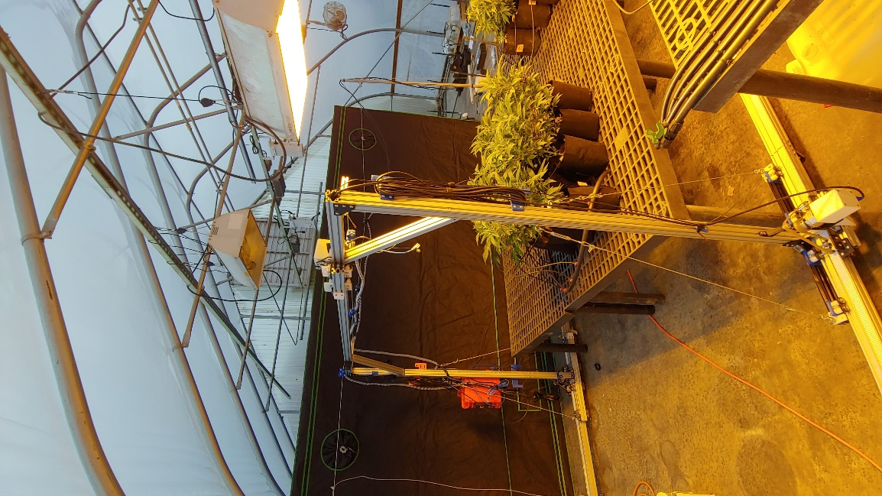
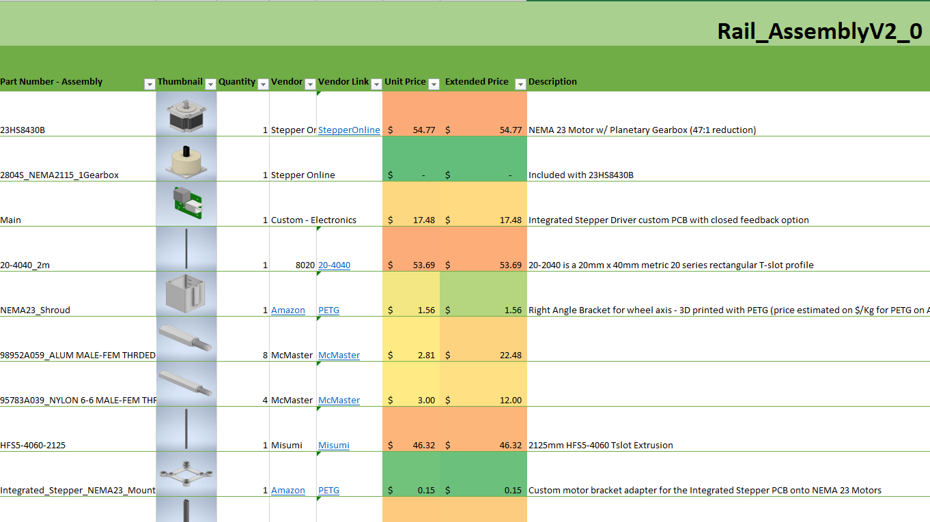
Project Timeline
Project Start
Winter 2021
First Revision
Sp/Su 2021
Second Revision
Fall 2021
Integration
Winter 2022
Documentation on Finalized CAD models
BOM with accurate prices
ME and IE Capstone Teams
Notes:
Finally this brings us to Winter 2022
Created finalized documentation based on revision 2.0
Finalized the BOM with updated prices
Integrated the finalized system up at NWREC
Worked with ME teams on iteration of mechanical design
Worked with IE teams on documentation and assembly tutorials

Slide 12
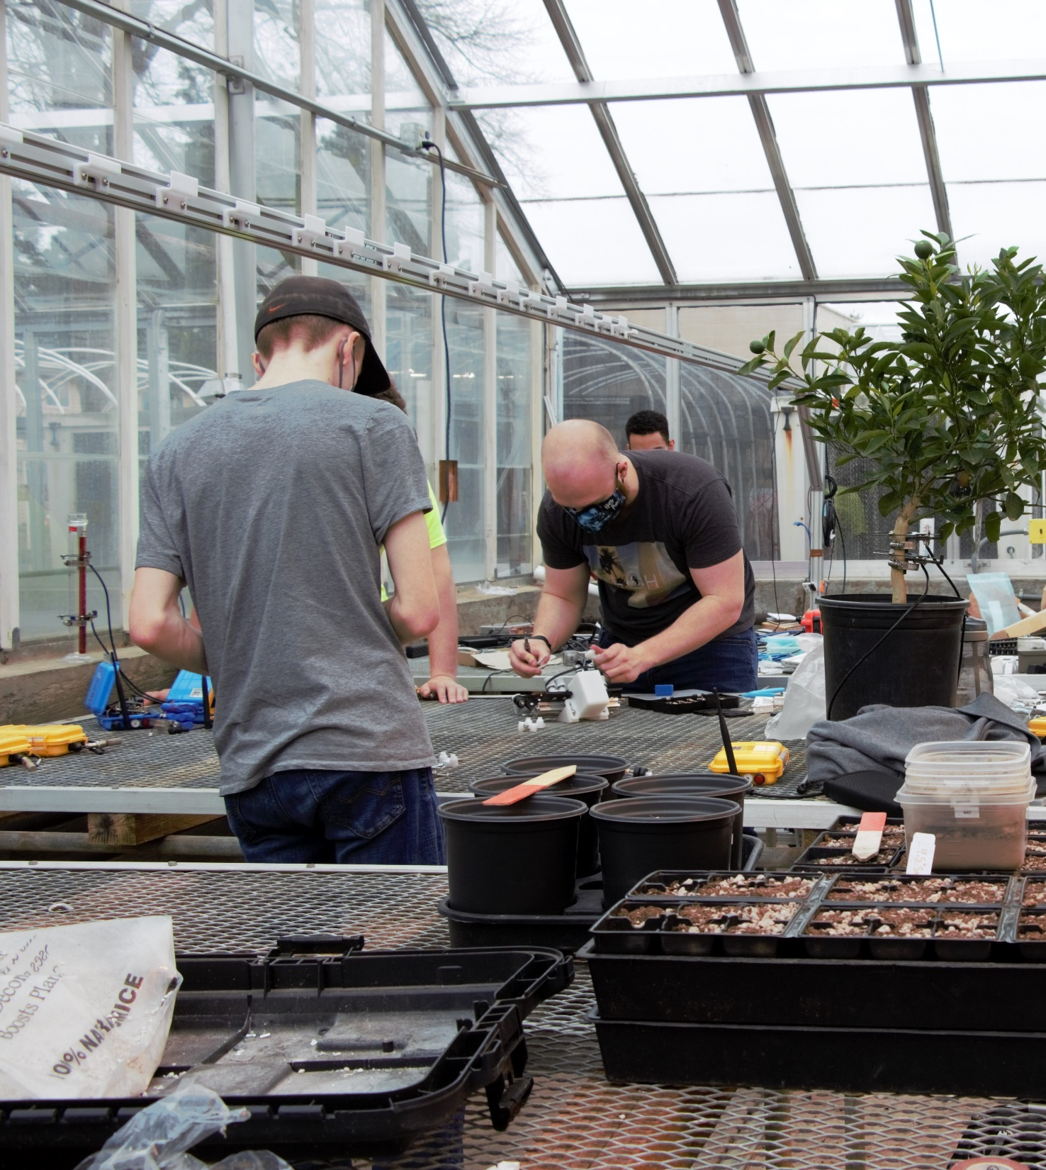
Multi-Disciplinary Teams
Winter 2021 – Electrical
4 teams, 4 – 5 people / team
Fall 2021 – Computer Science
1 team – 5 people
Winter 2022 – Mechanical Engineering
1 team – 5 people
Winter 2022 – Industrial Engineering
1 team – 4 people
Notes:
The capstone teams I led were varied in size and technical ability
Started with 4 teams of electrical engineering students each team was 4 – 5 people
In Fall 2021 I led a team of remote CS capstone students, 5 person team
This term (Winter 2022) I led 2 teams of ME and IE capstone students

Slide 13
Mechanical overview
Notes:
We’re going go through each section individually starting with the Mechanical Design - Build up the system sub-system by sub-system

Slide 14
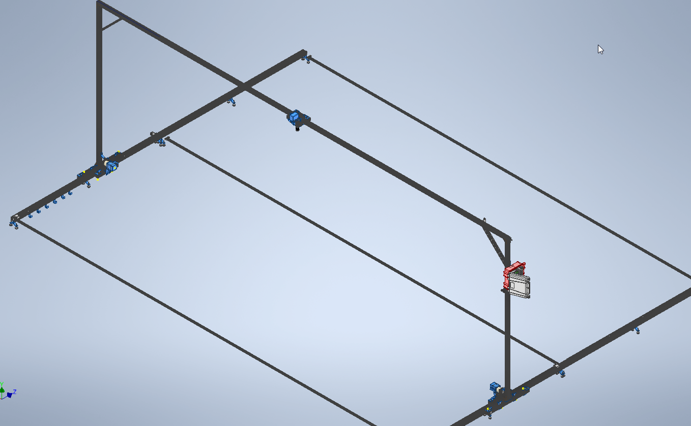
Design Objectives
Modular sub-assembly structure
Easy drop-in replacements
Iterative approach
T-slot extrusion base
8020 metric standard designs
Reliable linear motion over long distances
Common fasteners wherever possible
Notes:
The focus of the mechanical design was
Modularity
Standard materials (tslot extrusion)
Reliability over long distances

Slide 15
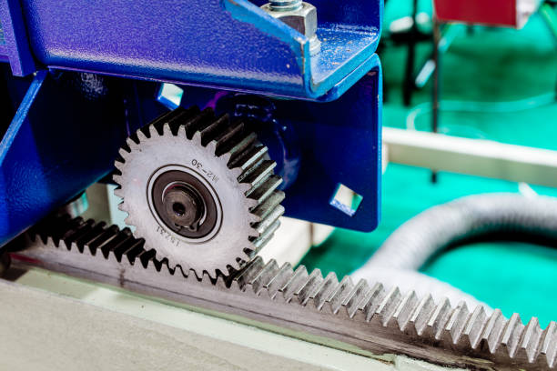
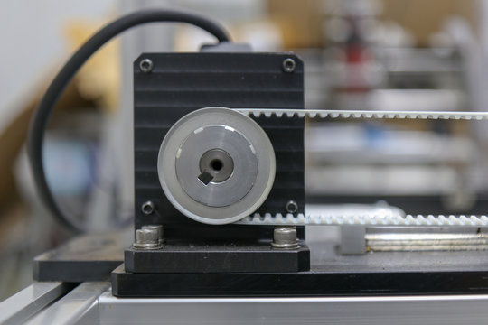
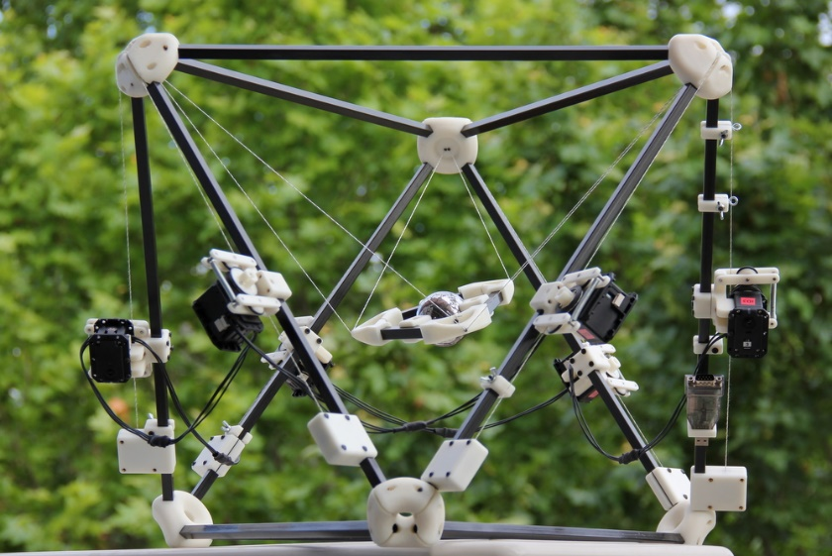
Possible Motion Platforms
Rack and Pinion
Reliable and easy to mount
Expensive per length
Timing Belts
Cost effective and documented support
Not as reliable and prone to stress
Ropes and Pulleys
Innovative and cost effective
Untested, possibly unreliable
"342 Rack And Pinion Stock Photos, Pictures & Royalty-Free Images - iStock." 4 Mar. 2022, www.istockphoto.com/photos/rack-and-pinion.
"Belt And Pulley Images – Browse 8,515 Stock Photos, Vectors, and Video." Adobe Stock, 4 Mar. 2022, stock.adobe.com/ca/search?k=belt%20and%20pulley.
"KRD's research in cable-driven robots." 20 June 2013, www.iri.upc.edu/people/ros/CableDriven.
Notes:
There are many options for linear motion
Rack and Pinion
Timing Belt and Pulley
Tensioned Cable

Slide 16
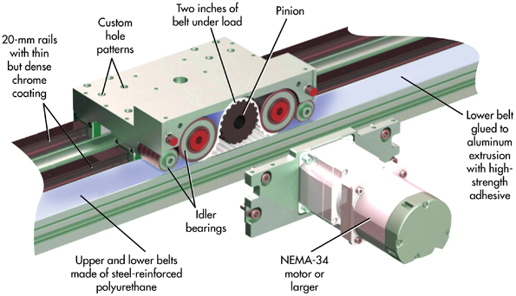
Chosen Method
Rack and pinion with belts
Benefits of both rolled into one
Belt stresses are reduced, reliability increased
Overall cost reduced
Easy to add additional length as necessary
"Bell Everman Servo Belt System - CNC Machines / Shapeoko - Carbide 3D Community Site." Carbide 3D Community Site, 31 Oct. 2018, community.carbide3d.com/t/bell-everman-servo-belt-system/10923.
Notes:
I chose to design with a rack and pinion with a tensioned belt
Less stress on the belt length
Low cost (belts < racks)
We can add length easily

Slide 17
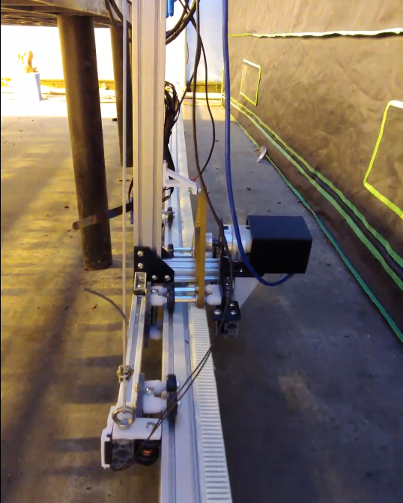
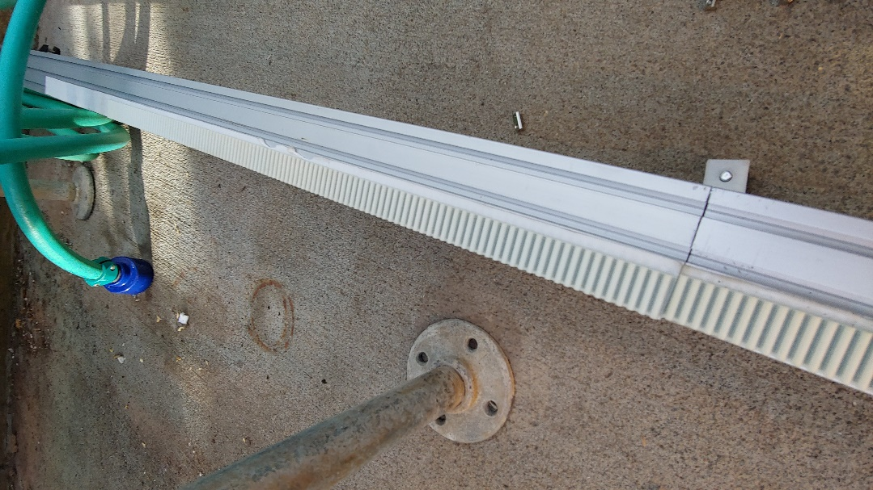
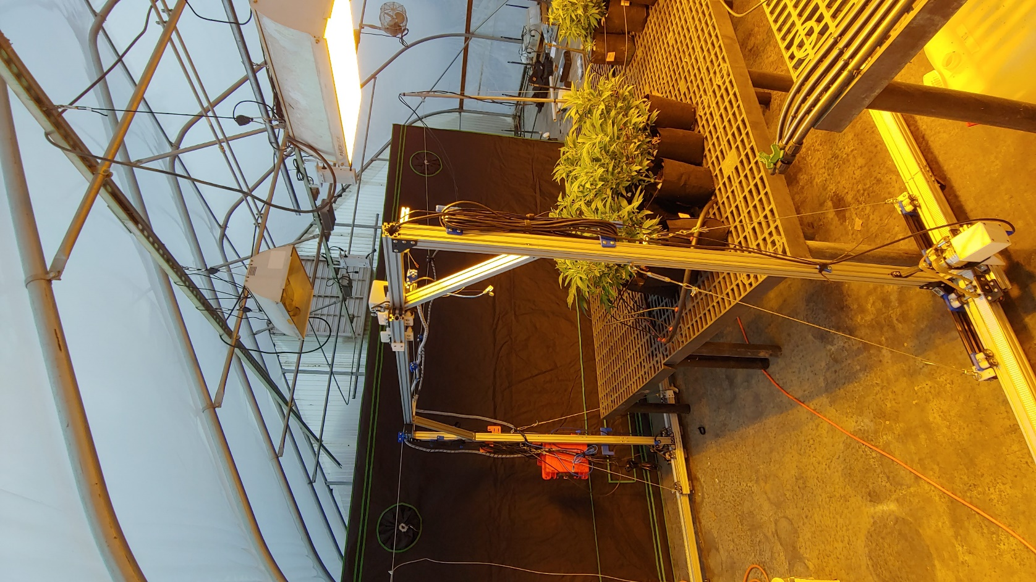
Full Assembly
Notes:
The mechanical design features a gantry-style CNC system
Dual X motors for motion
T slot aluminum extrusion for material
Adjustable caster feet for uneven ground
Belt system is adjustable with 2 different tensioners
Easily add track as necessary

Slide 18
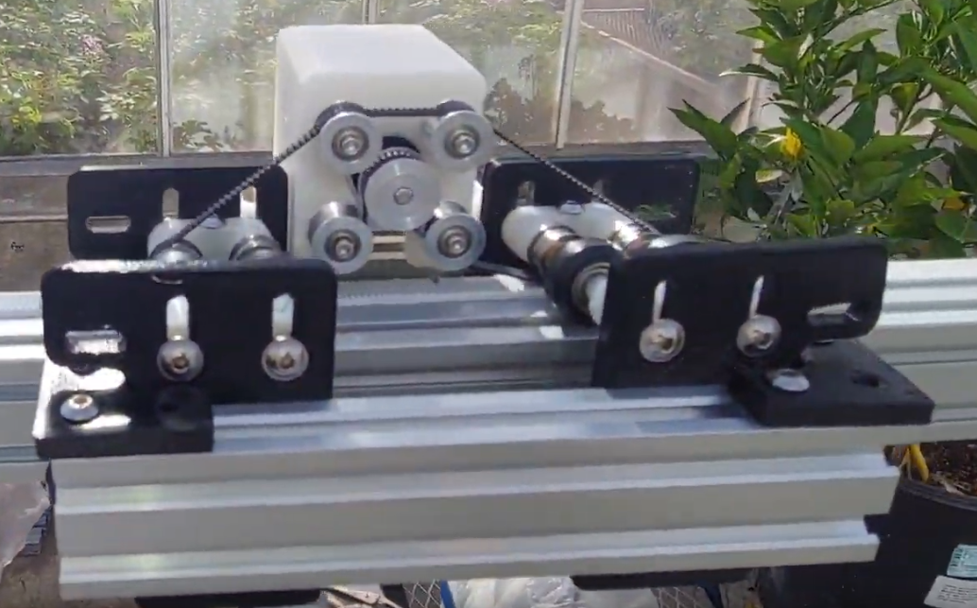
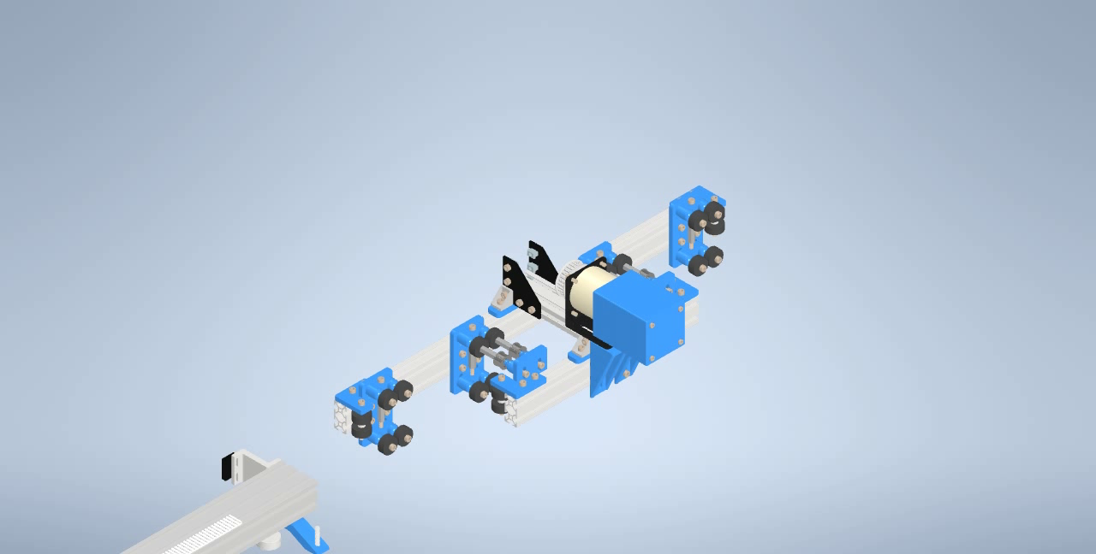
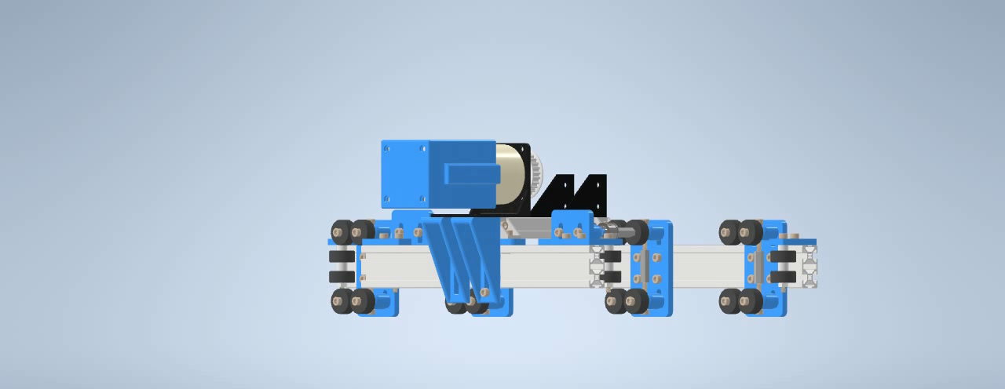
Highlights
High Torque X Carriage
NEMA 23 Stepper Motor w/ 47:1 Planetary Gearbox
Clamp style bearings
Mix and Match Sub-Assembly structure
Easy adjustment to length / width
Notes:
Some of the highlights of the current mechanical system are
High torque X carriages to carry a range of different loads
Clamp style bearings for adjustable rigidity on the tracks
Mix and match assemblies in CAD for easy upgrades
Simple adjustments to length and width

Slide 19
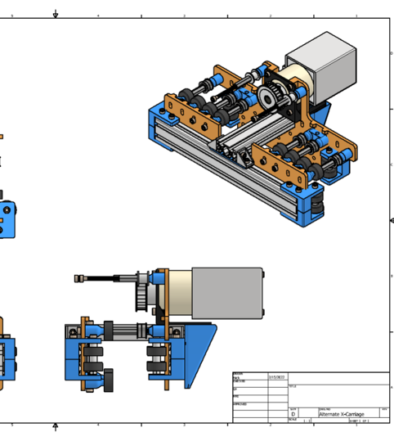
Capstone Team Contribution
Stability and rigidity improvement
Carriage assembly streamlining
Wire management

Slide 20
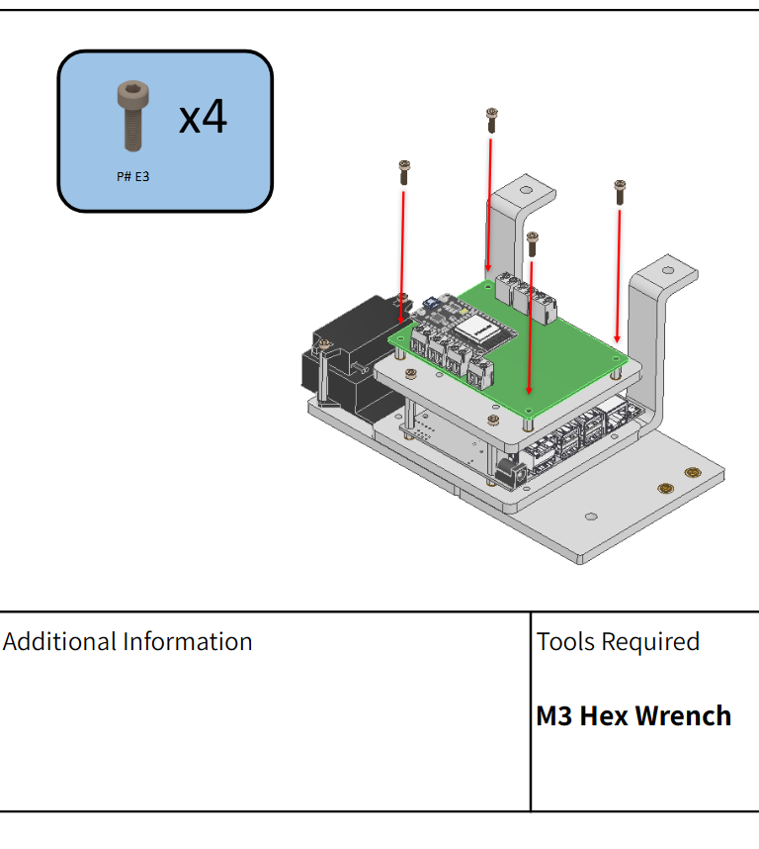
Capstone Team Contribution
Mechanical / Electrical Assembly Guides
Software installation and documentation
Bill of Materials documentation

Slide 21
Electrical overview

Slide 22
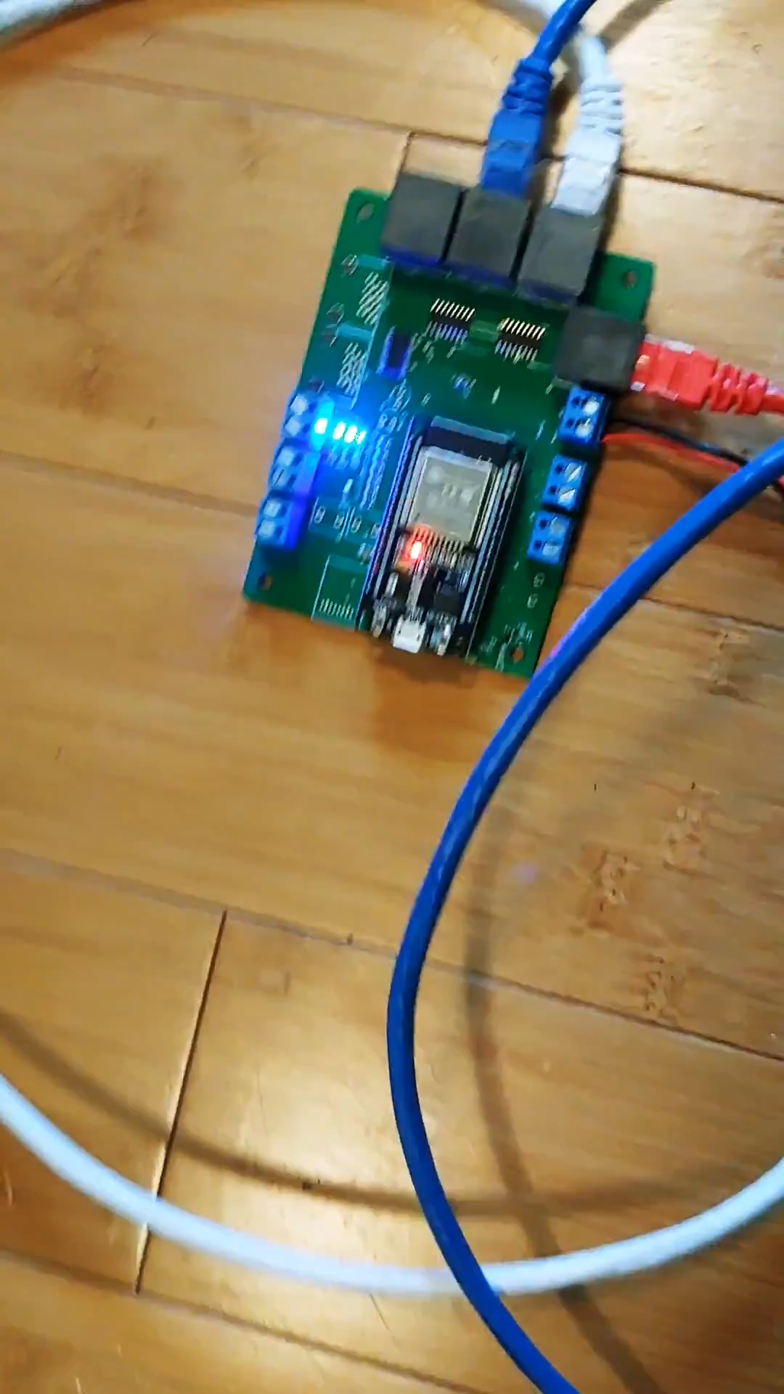
Design Objectives
Plug and Play prioritization
Ethernet based connectors
Low EMI, Commonly Available
Minimal hook up requirements
Motor inputs
End stop inputs
Camera + Camera power
Emphasis on system reliability
Vin range 12 – 36V
Internal shut-offs
Built-in water resistance
Notes:
For the Electrical portion I tried to focus on user accessibility
Plug and Play operation where possible
System Reliability and stand-alone operation
Water resistance where possible

Slide 23
System Diagram
Notes:
A system diagram was made to keep track of necessary components and systems
Main host is configurable to user (RPI, Jetson, Laptop)
GRBL firmware controller for desired motion
Stepper nodes to execute axis motion

Slide 24
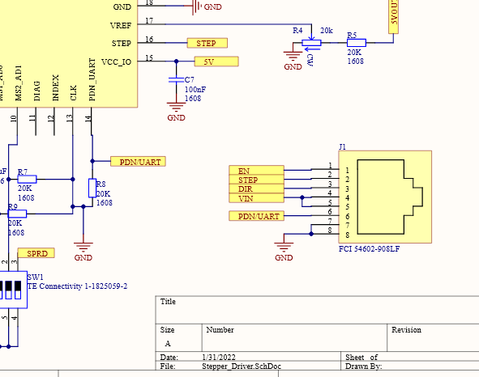
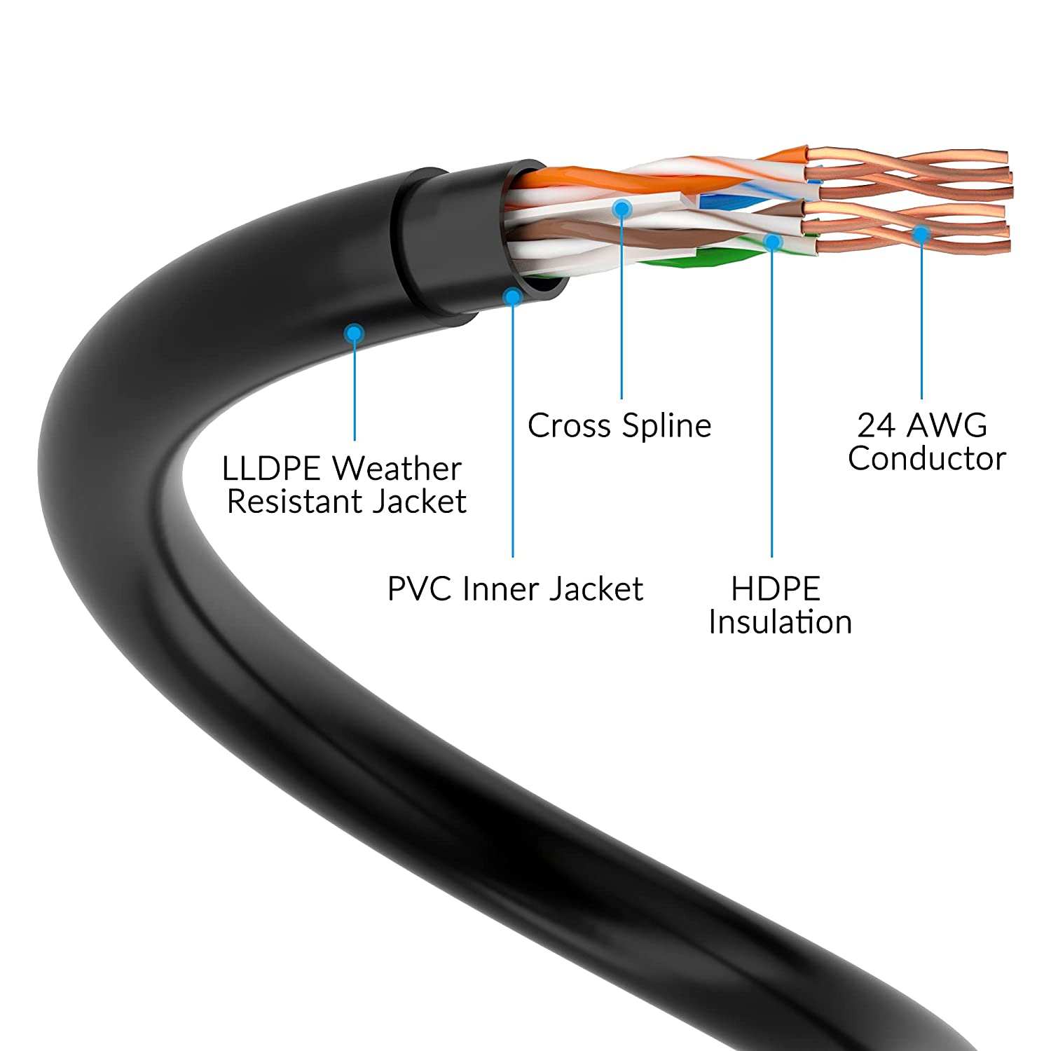
Power Over Ethernet*
Ethernet has efficient lumped model values
24AWG gauge possible
POE+ rated cables capable of 50W
"Cat6 Outdoor Ethernet Cable Heavy Duty 30 Feet (2 Pack) Cat 6 Network Internet (25ft to 250ft),Faster Than Cat5e,Waterproof UV LLDPE Douable Jacket for in Wall,Direct Burial,POE Camera with 25 Ties." Sept. 2009, www.amazon.com/Conable-CAT6-Outdoor-Cable/dp/B09P3DRT29.
Notes:
The idea behind the motors was that we could have separate “nodes” connected by a common interface, in this case POE
Ethernet cabling is readily available and has some very good lumped model circuit values
Low resistance and capacitance per unit length and great value
There is already a standard available for 50W power, we only need 24W
Cables can be rated for outdoor and underwater use

Slide 25
Integrated Stepper Driver
TMC 2209 or 2208 Driver IC
Low power, high current stepper driver
5.5 – 36V Supply Voltage
2A rms max motor current
StealthChop2™ technology
AS5047P Magnetic Rotary Encoder
14-bit on-axis encoder
SPI serial interface
Notes:
The most important element of the electrical design was the Integrated Stepper Driver
Operates on the TMC2209 or TMC2208 chipsets
Wide range of supply voltage
High current capabilities which are adjustable
Low noise operation
RJ45 connector for power and signals (Ethernet for most)

Slide 26
GRBL Controller
ESP32-WROOM module IC
240MHz clock
Xtensa® dual­core 32­bit LX6 microprocessor
Massive amount of I/O
GRBL Firmware port to ESP32
Built in WebUI and Wifi Access Point
RTOS backend
Fast boot time and easy to configure
Supports dual axes
Notes:
The GRBL controller serves as the main board for motion control
Uses an ESP32 at its heart to do computation
6 axis configuration or dual axis with 5 independent axes
Built in Web UI
Uses an RTOS backend to interpret commands and parse serial data

Slide 27
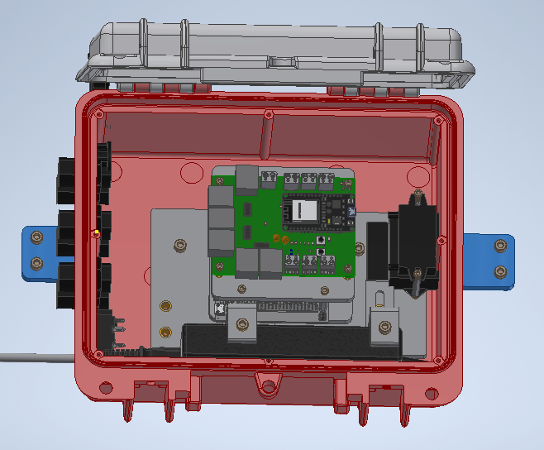
Electronics Box (Ebox)
Self-Contained main hub
Weatherproofing
Standard set of input glands
Only require network (ethernet) and power
Notes:
In order to consolidate the electronics as much as possible, an Electronics Box or Ebox was made
Contains main electrical components responsible for command and control
Power conversions done locally
Secure case with weatherproof qualities bought COTS
Only inputs required are Ethernet and Power, all else is localized to the moving component

Slide 28
Junior Design Team Contribution
Power distribution testing
Control Firmware Experiments
Stepper Driver IC selection
Manual operation features

Slide 29
Software overview

Slide 30

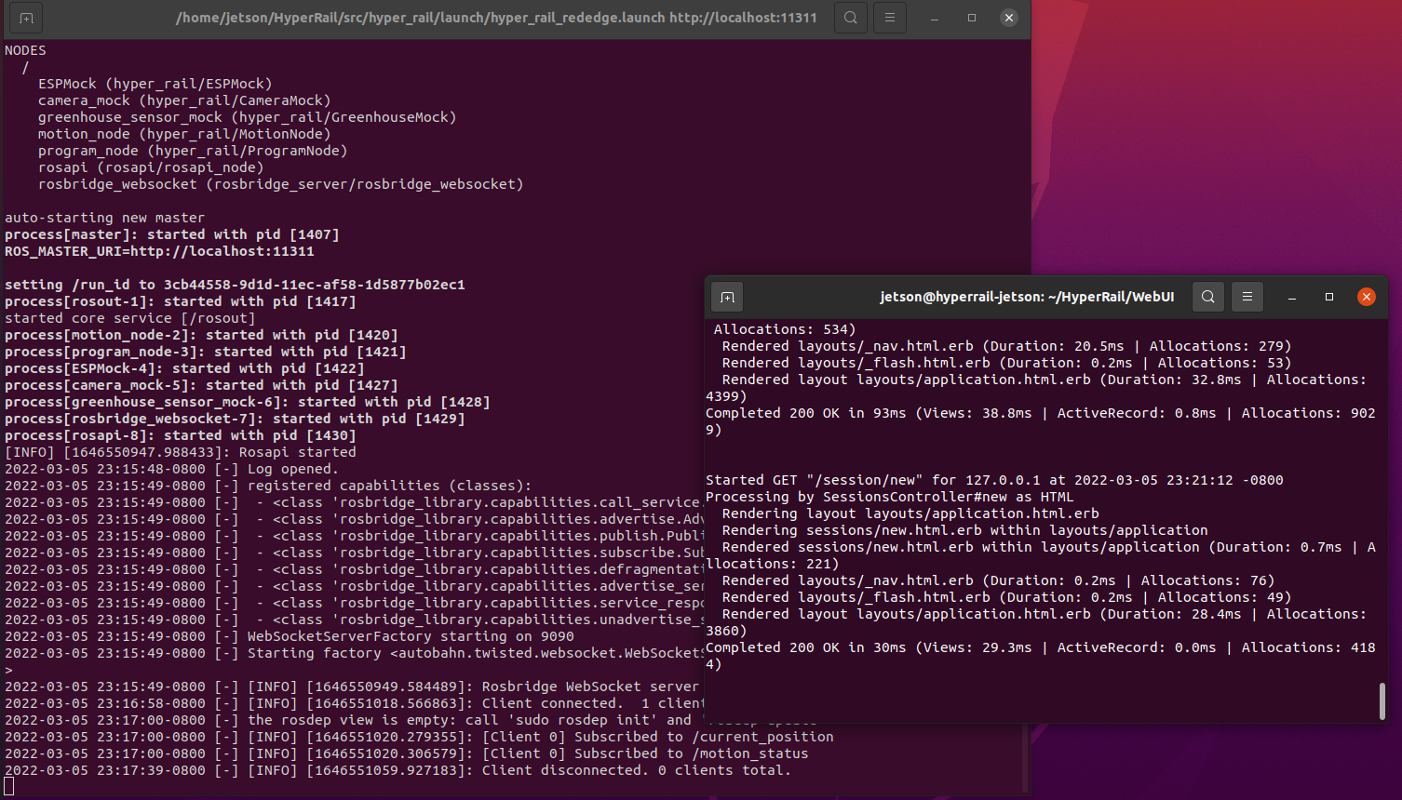

Design Objectives
Linux based OS
Python based code
ROS preferred for package management
Web Interface for User interaction
Built-in error handling and control
"Download Python." Python, 5 Mar. 2022, www.python.org/downloads.
"File:ROS cat.png - Wikimedia Commons." 19 Feb. 2022, commons.wikimedia.org/wiki/File:ROS_cat.png.

Slide 31
Capstone Team Contribution
ROS Node Development
Web Interface Development
Camera API testing and integration
Sensor package integration

Slide 32
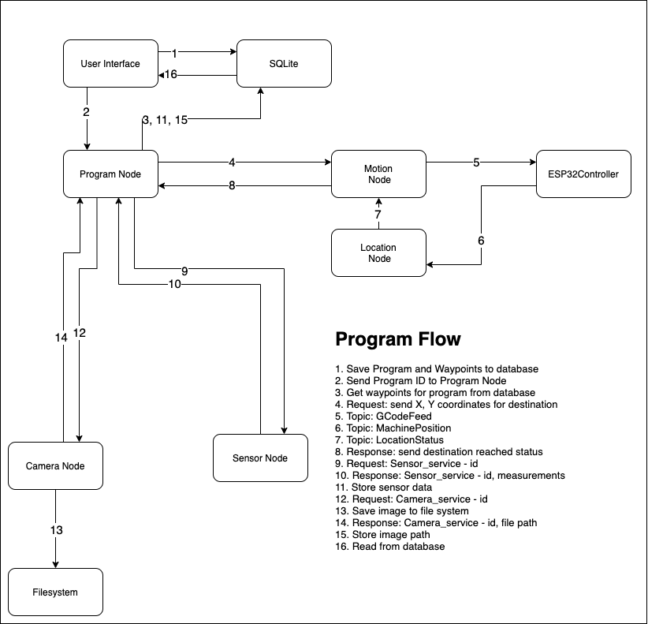
ROS Nodes
Program Node
Motion Node
ESP32 Node
Camera Node
Sensor Node

Slide 33
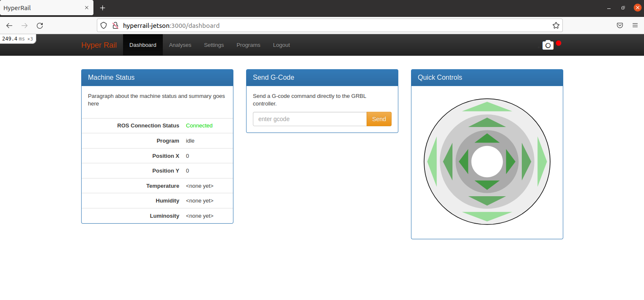
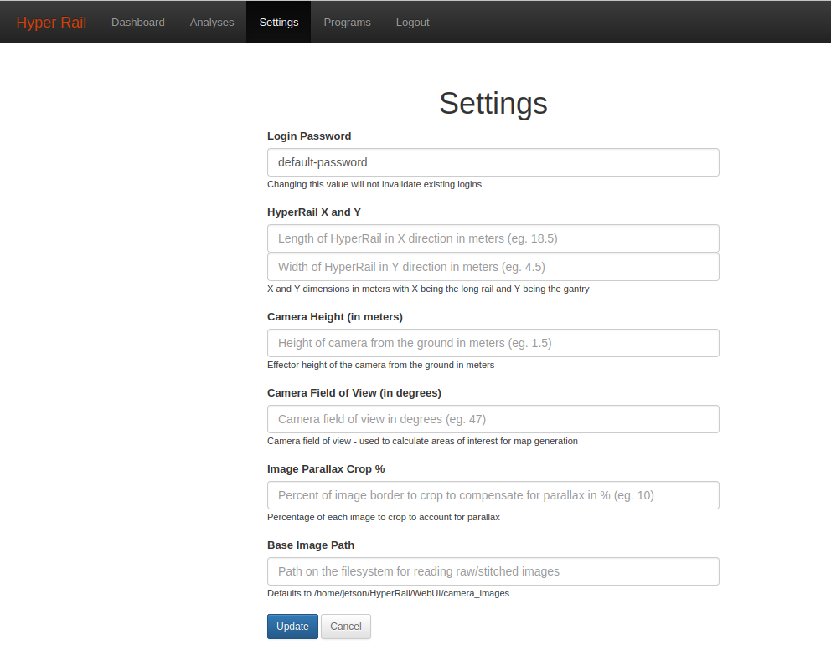
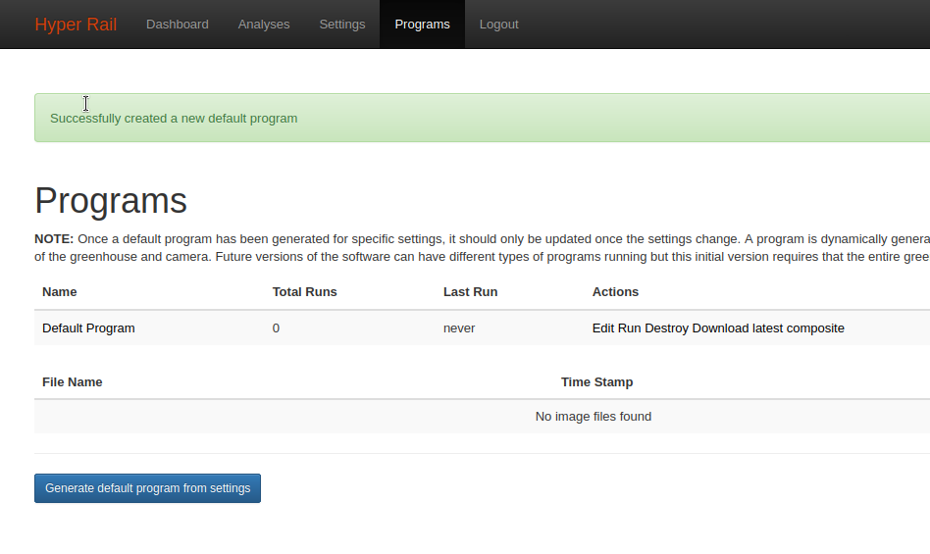
Web Interface
System Status
Custom data exportation
System settings and defaults
Program generation and operation

Slide 34
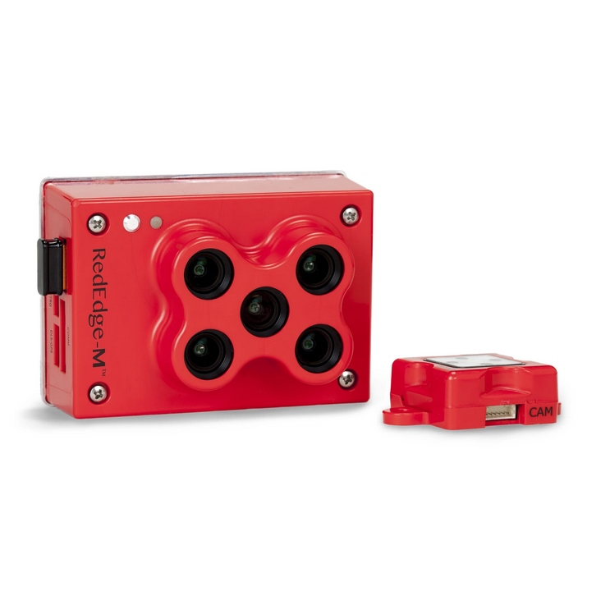
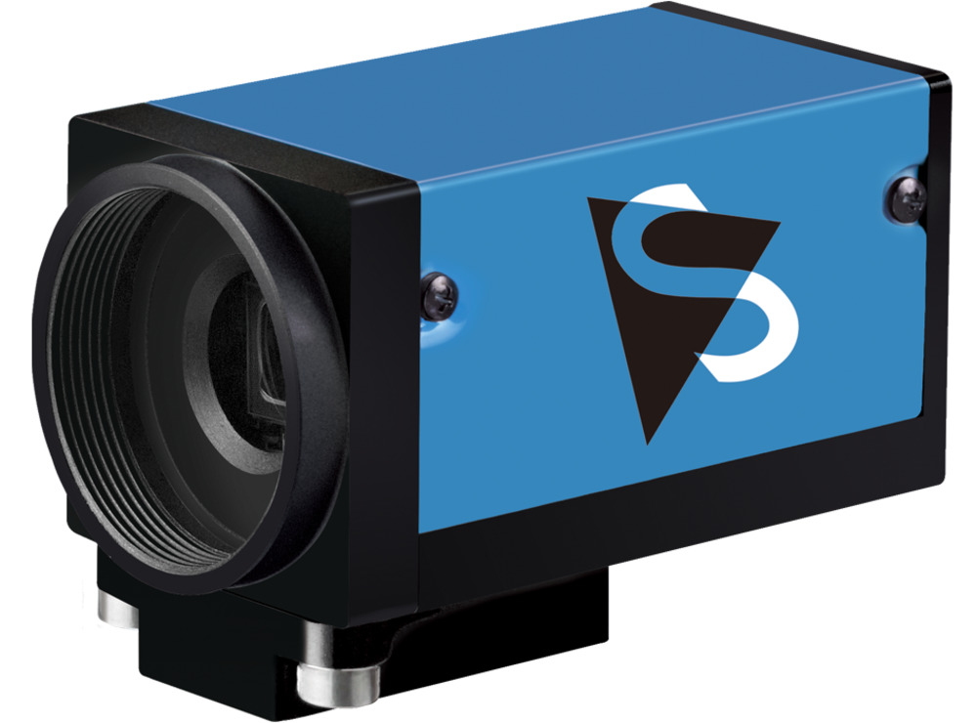
Camera Interface
"Micasense Rededge MX | Aeromao." Aeromao |, 11 Jan. 2021, www.aeromao.com/product/micasense-rededge-mx.
MicaSense RedEdge-M HTTP API
POST/GET requests for camera operation
5 Independent spectra outputs
DFK 33GP006
Custom TCP packet communication
1 RGB output
"DFK 33GP006 - GigE color industrial camera." 5 Mar. 2022, www.theimagingsource.com/products/industrial-cameras/gige-color/dfk33gp006.
Notes:
There were 2 camera interfaces we developed for the software
-MicaSense RedEdge M – Actual HyperSpectral camera we originally intended to use
-Developed by the capstone team, I refined it and added some bugfixes
I developed a node to handle the DFK33GP006 camera
- Machine vision camera which has high resolution, can be used for RGB NDVI

Slide 35
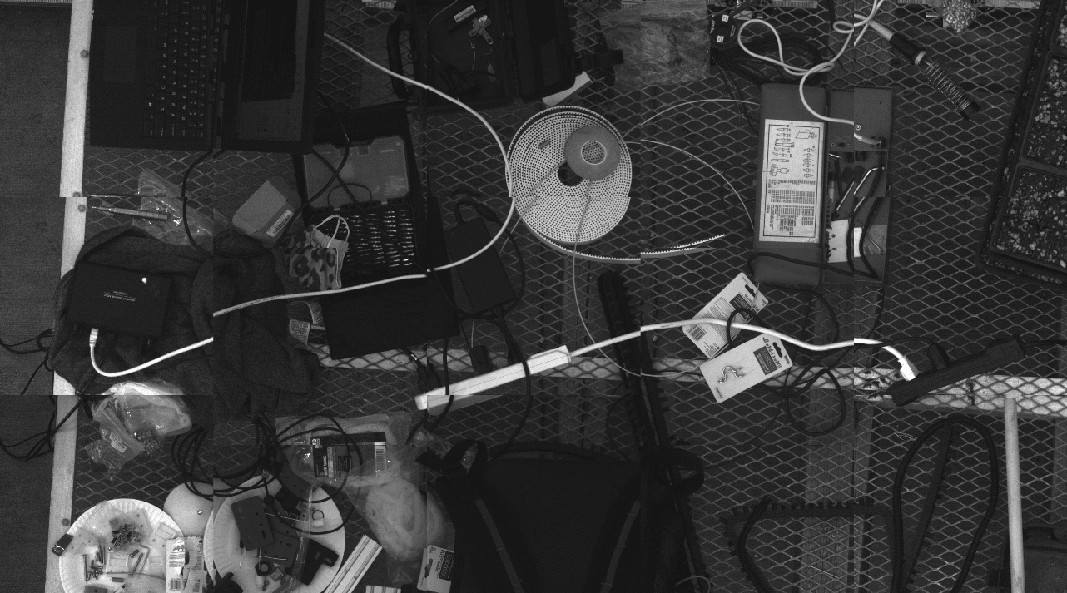
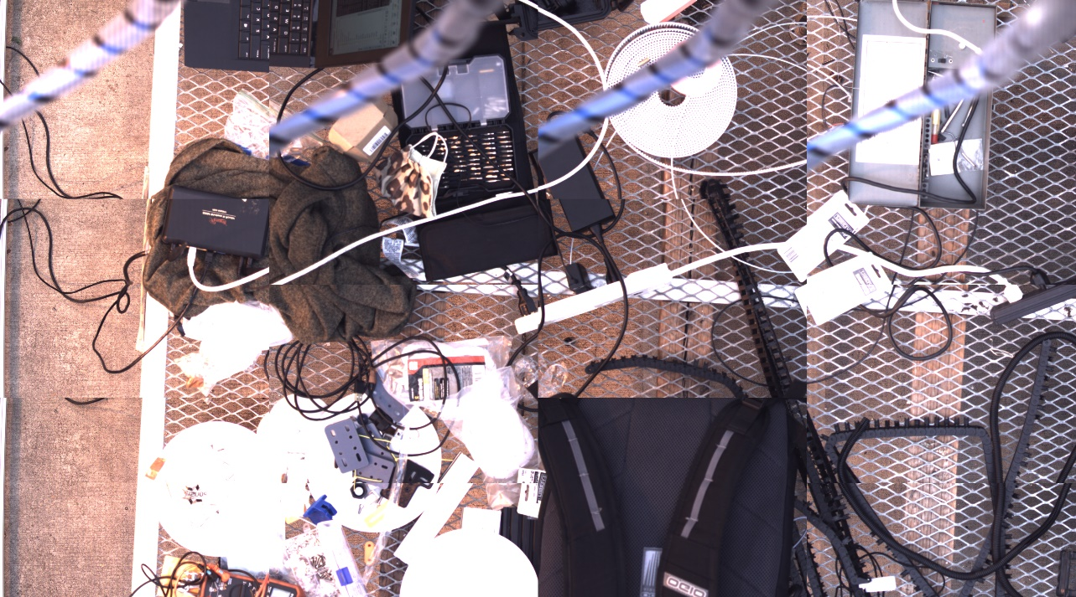
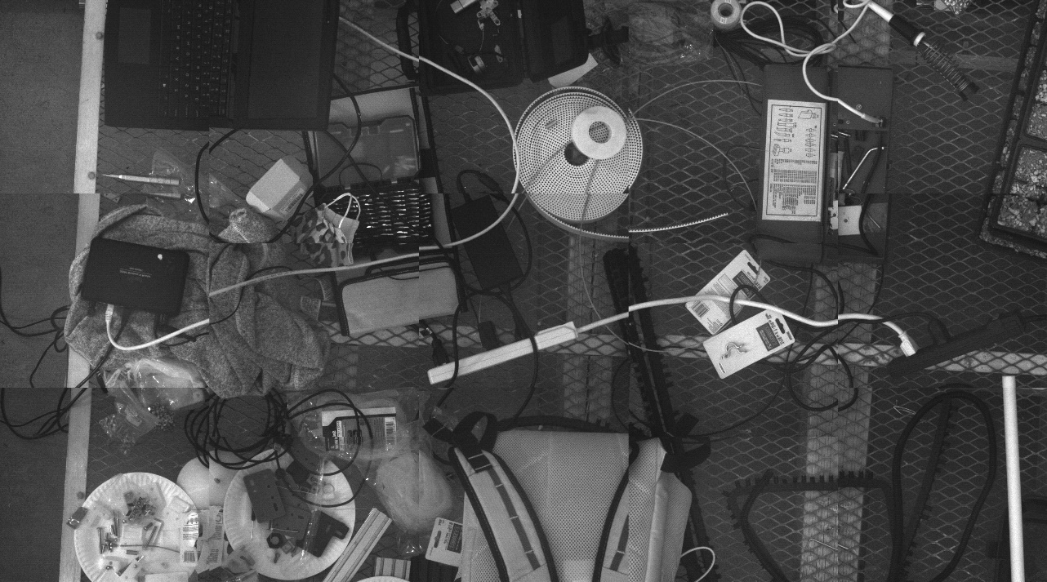
Results

Slide 36
Reflections and Future Iterations

Slide 37
Personal Ability
Strengths
Challenges
CAD Modeling
Controls / Motion Experience
Drive for documentation
Little to no mechanical experience
Supply logistics
Feature creep

Slide 38
Team Management – The Good
Responsibility
Communication
Structure
Create clear goals aligned with overall vision
Encourage buy-in and personal achievement
Use a common method of communication
Communicate early and often
Having a clear vision of the overall goal
Maintain regular meetings for feedback
Notes:
So with the undergraduate teams I led let’s talk about the overall good aspects
Responsibility - As a team lead its important to be clear and ensure the work is aligned with the overall goal
You know best how to engage team members and encourage them to do better
Helped to tie the project to personal achievement (they do good, they look good)
Communication
Important to communicate early and often so they can begin work
Use a standard form of communication so everyone knows how to contact you
Structure
Maintain regular meetings for feedback and to keep everyone on track

Slide 39
Team Management – The Bad
Accountability
Documentation
Empowerment
Backup plans for failure
Managing expectations
Reasonable requirements
Ensure record keeping for future work
Standardize repositories for information
Give teams more flexibility
Let individuals make decisions independently
Notes:
Some things that I think were challenging from a team management perspective were
Creating accountability
- It was challenging being able to figure out exact expectation, especially with different teams
Need to have a backup plan in case the teams results end in failure
Documetnation
- While I tried to encourage documentation, ultimately it’ll be different for different teams
-- Need a common repository so it doesn’t end up everywhere
Empowerment
-- Give teams more flexibility to try out new ideas instead of the ones I want

Slide 40
Potential Improvements
Mechanical
Electrical
Software
Improved stability for load bearing carriages
Simplified assembly
Upgraded firmware
Positive and Negative Limits
More visuals on the website
RGB NDVI measurement using CV
Notes:
Finally I’d like to talk about the potential improvements that could be made to the system as it is
-Mechanical
Improved stability for longer lengths of track
Electrical
- There’s an updated firmware version that can be deployed which offers more features such as easier limit switch setup
Software
- RGB NDVI measurement can be automated and verified

Slide 41
THANK YOU

